Slide 1
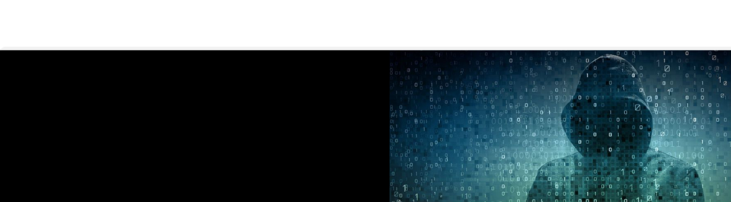
Detecting and Avoiding Phishing Attacks
Phishing Training

Slide 2
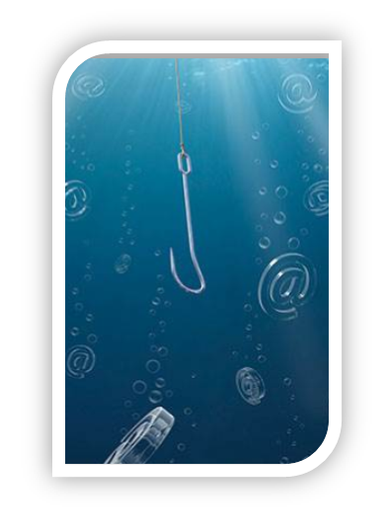
Course Agenda
Phishing overview and types of attacks
Identification of phishing emails
Consequences to falling prey to phishing
Human Behavior and Cyber Security

Slide 3

Objectives
After completing this course, you will:
Understand the types of phishing attacks and how to identify them.
Understand how personal work habits contribute to secure behaviors.
Understand the consequences of falling victim to phishing attacks.

Slide 4

Overview
Phishing is a form of fraud where cybercriminals attempt to collect information from a user by posing as a legitimate source (e.g., financial institution) to steal personal information, money, financial data, trade secrets, or gain access to computer systems, among other activities.
It is important for you to understand:
The potential impacts on victims.
The tactics used in phishing scams.
Behavioral modifications that users can implement to protect themselves and their families, friends, schools and employers.

Slide 5

Media Break
Review the following video. If remote users are attending, ensure they have completed viewing the content before moving on.
Massive Hacking Strike Affects Millions
http://merlin.ml.local/landd/SitePages/Phishing-Wannacry.aspx

Slide 6


How Phishing Impacts YOU
Both the personal and professional lives of the victims of
cybercrimes can be impacted in a wide range of ways, such as:
Lost time
Trauma
Financial loss
Social consequences
Business consequences
Lost productivity
Disciplinary Review

Slide 7
How Phishing Impacts YOU
Lost Time
Depending on the type of damage caused by a phishing attack, victims can spend anywhere from a few hours to many months or years resolving the associated problems.
Trauma
Can cause significant emotional distress such as:
  Denial, loss of trust, frustration, fear, anger, powerlessness, helplessness, embarrassment, depression, sleep disturbances.
Can be more harmful to victims than crimes like property theft because one can replace property, but it is not possible to acquire a new identity.

Slide 8
How Phishing Impacts YOU
Financial Loss
Damage can be both direct (i.e., value of goods, services, or cash obtained) and indirect. (e.g., legal fees, bounced checks, postage)
In 2014, victims of identity theft reported an average combined direct and indirect loss of $1,343.
Employers of phishing victims can experience financial losses.
Estimated total annual cost of phishing for the average company is $3.77 million.

Slide 9
How Phishing Impacts YOU
Social Consequences
Strains on personal and family relationships and reputational damage.
Can uncover information about personal relationships or embarrassing photos or videos that may be leaked to the public.
Family or friends could also become the targets of cybercriminals.
Business Consequences
Intellectual property and customer data can be at risk.
A phishing attack can damage the reputation and credibility of a business.
Attacks allow cybercriminals to gain backdoor access to a system network.
It can take months to years to detect a network compromise.
Cybercriminals can have long periods of undetected access to trade secrets that can hinder business growth.

Slide 10
How Phishing Impacts YOU
Lost Productivity
Can result in decreased employee productivity.
It is estimated that non-IT employees spend an average of 4.16 hours per year dealing with phishing attacks.
Estimated to be $1.8 million annually, accounting for 48% of total organizational costs.

Slide 11
Types of Phishing

Slide 12
Types of Phishing
Click Only
Employs a simple hyperlink to a malicious site to exploit a user’s system compromising the OS and the Network.
Data Entry
Directs the user to a site that is collecting information.
Seeks to gain personal information or login credentials.
Attachment
Attachments such as Word or Office doc, PDFs or other files.
Often made to look like invoices or other business related documents.
Asks the user to review in resolving some kind of issue.
Simply opening these documents is all it takes to compromise a system and an entire network.

Slide 13
Types of Phishing
Double Barrel
Begins with one email (the lure) that is innocuous and does not require any response from the victim. It could be a simple introduction such as:
`Hi, we met at CES last week and had a great conversation! I have a white paper I’d like to share with you based on what we talked about and will send it over shortly.’
Later the mentioned white paper appears and the victim is now conditioned to receive and open it.
Delivery order can also be reversed.
The goal is to send the lure before the malicious email in order to give the victim a sense of confidence in the whole experience. Social engineering is at the heart of every phishing attack.

Slide 14
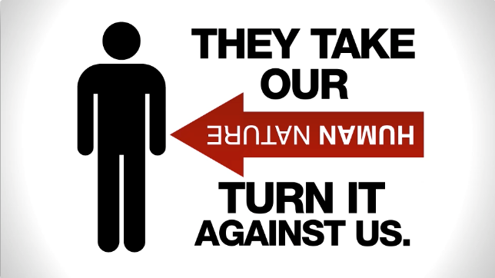
Why is Phishing So Successful?
Phishing attacks often rely on a combination of tactics that are known to influence human decision-making, such as:
Authority
People tend to comply with requests from authority figures.
Claim to be from a trusted source by using a corporate logo or name as the sender
Attempt to create legitimacy and credibility.
Time Pressure
Phishing frauds may request a rapid response to pressure users to act quickly, and decrease the time users have to uncover the fraud.

Slide 15
Why is Phishing So Successful?
Tone
Formal tone with a combination of persuasive and polite statements to influence user decision making. (e.g., Dear, Thank you, Kind regards); trigger words (e.g., alert, warning, attention); and persuasion (e.g., upon verification, restrictions will be removed).
Salient Pieces of Information
May include personalized messages or salient pieces of information (e.g., primary account contact) to persuade a user that the email is legitimate.
Cybercriminals build a target profile based on public available information to increase the likelihood of a successful attack.
Fear
May invoke fear by making threats (e.g., account restrictions) or
leveraging current events (e.g., natural disasters, health epidemics,
economic concerns, political elections, holidays, etc.).

Slide 16
Phishing vs. Spear Phishing
Both phishing and spear phishing share the goal of manipulating victims into exposing sensitive information. Spear phishing is more targeted and personalized in order to increase chances of fooling recipients.
Attackers will gather publicly available information on targets.
Often use personal details to impersonate targets’ friends, relatives, coworkers or other trusted contacts.
Can leverage employment information, organizations that they belong to, hobbies, and other personal details.
Much of this information can be found on social media sites.
Often used as a first step in an Advanced Persistent Threat attack targeting a specific organization.

Slide 17
Media Break
Review the following video. If remote users are attending, ensure they have completed viewing the content before moving on.
Real Future – What happens when you dare a hacker to hack you
http://merlin.ml.local/landd/SitePages/Phishing-Real_Future.aspx

Slide 18
Human Behavior and Cybersecurity

Slide 19
Preventing Phishing Attacks Requires Behavioral Change
Phishing relies on behavioral factors to influence users. How individuals perceive risk can explain why users exhibit poor security habits. For example:
Users may be overconfident, believing that they will not be the target of a cyber-attack. (i.e., normalcy bias)
Users may believe that the issue is irrelevant to them because they have not been a victim or known a victim, leading them to delegate cybersecurity measures to others such as I.T. and Enterprise Security.
Work habits may contribute to vulnerabilities such as multi-tasking or “reflexive” application usage.
Users must incorporate behavior changes into their regular online activities to prevent successful phishing attacks.

Slide 20
Why Behavior Matters in Cybersecurity
Phishing and social engineering techniques are used to defeat data and system security by exploiting weaknesses in decision-making and human behavior.
Approximately 95% of cyber-attacks and events involve preventable human error and behavioral weaknesses.
This number suggests that Internet users are vulnerable, independent of platforms and software. Psychology plays an important role in why individuals engage in risky cybersecurity practices.
We must shift from Security Awareness to Security Action

Slide 21

Why Behavior Matters in Cybersecurity
Arun Vishwanath, associate professor of communication at the University of Buffalo, has done social-psychological research on phishing and found “ineffective cognitive processing” to be the key reason victims fall for fake emails.
“Even after training to detect deceptive emails, people tend to quickly sink into bad habits.” he said.

Slide 22
Why Behavior Matters in Cybersecurity
Risk beliefs, including misperceptions about device security, are another factor.
“We ask people, what do you think is safer, a PDF or a Word document?” Vishwanath said. “What do you think is safer, an iPhone or Android device?
People have these beliefs about what is safe and what is not, and most of them have nothing to do with malware attacks.”
iPhone users, for instance, are more likely to click on malicious links than Android users, falsely believing they are safe.

Slide 23
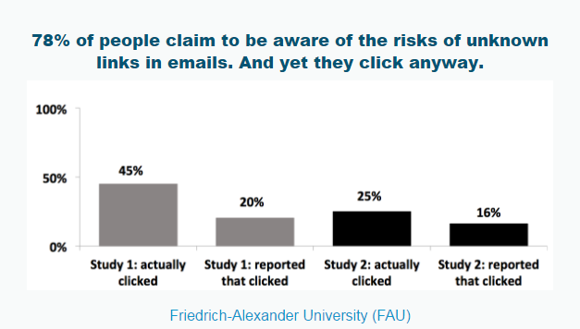

Why Behavior Matters in Cybersecurity
What does the following graph say to you about perceived risk to the end user?

Slide 24

Evaluating Risks
When looking at your day-to-day work, what are the most hazardous activities and tools you encounter? It is true that there are countless ways that you can fall prey to malicious activities, but what are the most likely you will encounter?
If you were to choose two of the most “dangerous” tools or activities, what would they be, and why?

Slide 25
What Do We Fear?
They say fear is a motivator. So, how does the possibilities of being breached through a phishing attack stack up with other concerns that society, or we, have? When faced with the statistics, do we adequately understand how vulnerable we are?
Take the following situations and think about your own concerns. Do you feel more or less susceptible to these eventualities? Rate your level of concern (from 1 to 5, 5 being the greatest concern) against each entry and enter your guess on what the odds are of the event happening to you.
Being the victim of a single phishing attack
Being the victim of phishing in 2012
Being the victim of a terrorist attack
Dying due to accidental poisoning
Dying in a car accident (annually)
Child being born with extra fingers or toes
Being murdered
Dying as a pedestrian
Having identity stolen
Dying from a lightning strike

Slide 26
What Do We Fear?
What are the odds?
Event | Estimated Odds
Being the victim of a single phishing attack | 1 : 177,304
Being the victim of phishing | 1 : 6448
Being the victim of a terrorist attack | 1 : 20,000,000
Dying due to accidental poisoning | 1 : 119
Dying in a car accident (annually) | 1 : 19,000
Child being born with extra fingers or toes | 1 : 500
Being murdered | 1 : 18,690
Dying as a pedestrian | 1 : 701
Having identity stolen | 1 : 18.2
Dying from a lightning strike | 1 : 134,906

Slide 27
Phishing Prevention Tips

Slide 28
Phishing Prevention Tips
Check the Sender
Are the name and the email address the same? (e.g., the “from” address text says the institution’s name but the email address does not.)
Does the email address have the same domain name as the company’s website? Look out for variations in spelling and domain (.com, .net).
Unsure? Contact the sender or company directly using information on your account statement or found online. Do not use the email address, phone, or website included in the message.

Slide 29
Phishing Prevention Tips
Identify the Recipient of the Email
Does the salutation include your name?
If it includes salient pieces of information, are those accurate? (e.g., are you the primary contact on the account?)
Does your name appear in the “To:” address line or are there variations in the CC: line?

Slide 30
Phishing Prevention Tips
Carefully Read the Message
Does the message contain errors such as typos and poor grammar?
Does the message contain threats or invoke fear?
Does the message request an urgent action?
Does the message ask you to log into a site or application?
Does the message imply you must provide information the site should already have expecting you to confirm or change it?

Slide 31
Phishing Prevention Tips
Know Where the Links Will Take You
Check the URL before clicking any link
(Hover over the hyperlink with the mouse pointer. In mobile applications, hold down on the link (anchor) to see the real target URL before visiting it.)
Do the hyperlinked text and the URL match?
Is the domain in the URL the same as the company’s website?
Look out for variations in spelling and domain (.com, .net).
Look for similar looking text attempting to dupe you into trusting them (i.e. www.rnicrosoft.com, www.h0tmail.com, www.goog1e.com)
Type the website address into a browser manually instead of clicking the link.

Slide 32
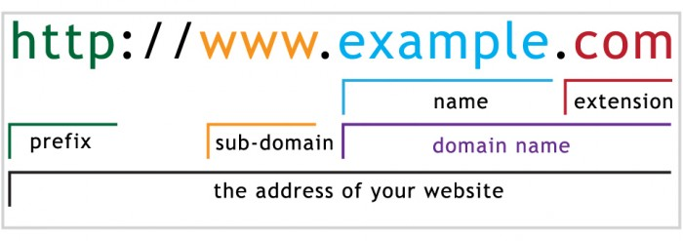
What’s In a URL?
Prefix
The URL prefix identifies the protocol that is being used. This includes standard web pages and secure sites (http/https), File Transfer Protocol or FTP, streaming media services (rtmp, mms) or other technologies.

Slide 33
What’s In a URL?
Sub-domains
Sub-domains point to computers or instances of web servers within a company’s domain. These could be servers handling normal web pages (www), web-based email servers, vpn services or more. Sub-domains can be named anything the domain owner desires.

Slide 34
What’s In a URL?
Name
The name of a domain is the most recognizable part of the URL, generally being the name of the corporation or entity. (Merchant Link = merchantlink). This can be anything the domain registrant desires as long as it has not been reserved already.

Slide 35
What’s In a URL?
Extension
In all but the rarest cases, this is typically a “.com”, or commercial extension. Since that is one of the oldest and most recognized extensions, it is rare to see any company of repute or significant size to be using a different extension for their primary web presence. Extensions can also be identifiers of the nation or region such as .uk or .ru for England and Russia.

Slide 36
What’s In a URL?
Top Level Domain (TLD)
These terms refer to the Name and Extension as a combined entity (merchantlink.com) Depending on what is being discussed, the TLD or Top Level Domain may be referring to only the extension in an URL. The “top – down” concept of an address starts at the extension and works its way to the left, becoming more specific as it goes. TLDs are registered typically to a company in a specific geographic region.

Slide 37
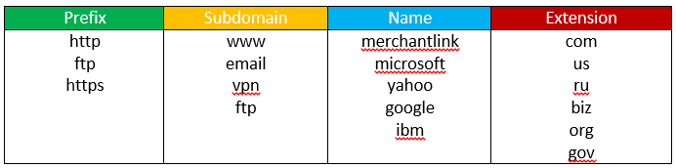
What’s In a URL?

Slide 38
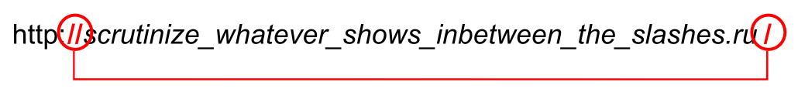
Look Between The Lines
When trying to detect a legitimate URL you will look for the first instance of a forward slash AFTER the http(s):// of the URL. The entry between these forward slashes will be the Fully Qualified Domain Name (FQDN) for the site you are interacting with.
From the slash, work your way from right to left to identify the parts of the URL and its legitimacy

Slide 39
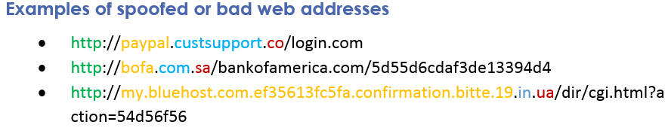
Look Between The Lines

Slide 40
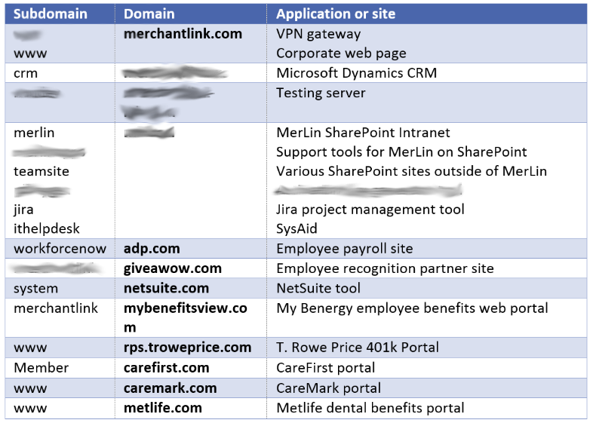
Look Between The Lines

Slide 41
Phishing Examples

Slide 42
Phishing Examples
It was an unsolicited email.
Do you expect email from webaccess-alert.com?
Hover the mouse over the anchor to see the real link before clicking it
Internal company announcement emails should be sent from this address “MerLin Commcenter <ssp-merlin@merchantlink.com
When in doubt, report any potential phishing email using the Outlook Report Phishing button

Slide 43
Phishing Examples – Spear Phishing
Do you recognize the sender? It was an unsolicited email.
Do you expect email from the domain, VerifyToken.com?
It has an attachment
Reminder: When in doubt, report any potential phishing email using the Outlook Report Phishing button.

Slide 44
Phishing Examples – Spear Phishing
Do you recognize the sender? It was an unsolicited email.
No ML administrator should send email from an email address like this admin@mycorporate-rewards.com
Do you recognize the sender domain name (mycorporate-rewards.com)?
Do you hover the mouse over the link to see the real target URL.

Slide 45
Pause, Think, Act.
Think Before You Click Links or Open Attachments
NEVER open attachments or click links that you are not expecting.
While the I.T. group and Enterprise security ensure your anti-virus software/security settings are up-to-date and enabled, never assume that you are protected.
Treat every link and attachment as a potential attack. Break the cycle of vulnerable work habits

Slide 46

Pause, Think, Act.
Distracted Computing
Changing how you perceive and use email is the start to securing your behavior.
Consider the following behavioral changes:
Set a schedule for checking email and stick to it:
  Check emails no more than once an hour, or at set times.
  Determine the priority, park non-critical ones for later.
Use email filters to organize more common
notifications of lower priority.
Separate work and personal communications to
eliminate friendly distraction.

Slide 47
Pause, Think, Act.
Identify the security vulnerabilities or behaviors you can improve on. Devise actions you will take to correct and increase your security practices.
Changes to Work Habits
What work habits can you improve to become more secure?
Improved Threat Identification
What technical limitations do you need to improve upon?
Technical Gaps
What technical subjects do you feel you do not fully understand?

Slide 48
Questions?
?

